Slide 1
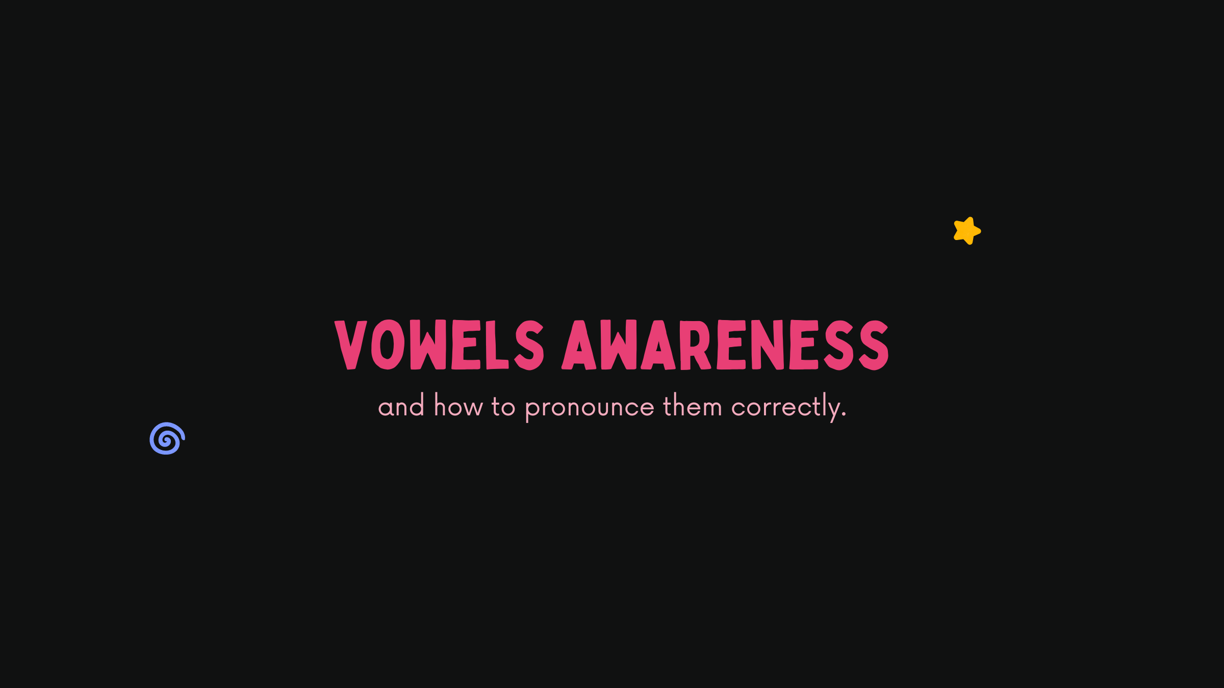

Green /i:/ & silver /ɪ/ white
-ght
EAR TRAINING:

Slide 2
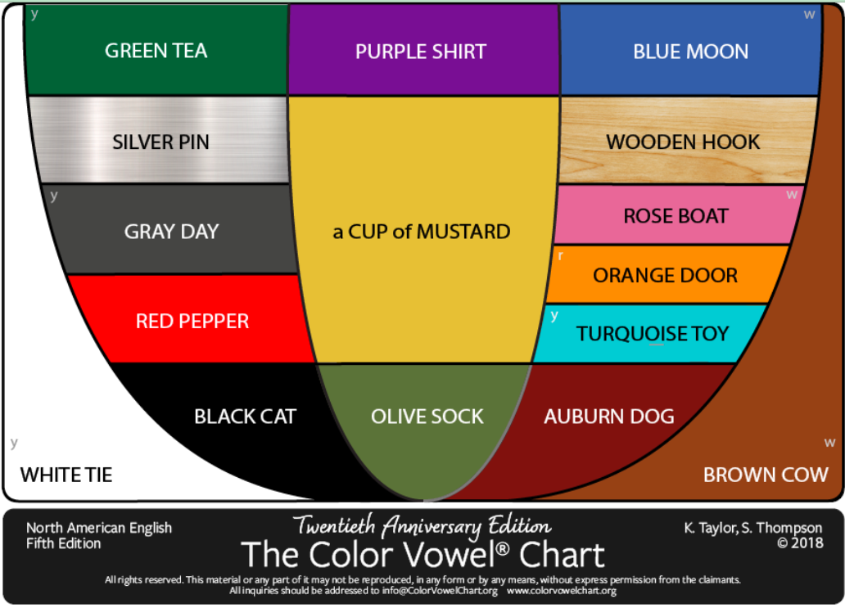

The color vowel® chart

Slide 3
Pada PPT ini, terdapat kata-kata berpasangan (yang letaknya bersebelahan, misal: BEAD dan BID) dengan bunyi yang serupa, namun sebenarnya berbeda. Namanya adalah Minimal Pairs, atau pasangan kata dengan perbedaan bunyi yang sangat sedikit.
The color vowel® chart
Your mission is to listen to the differences. Latih telingamu untuk bisa mendengar perbedaan dari bunyi-bunyi yang berpasangan tersebut. Setelah itu, coba ulangi dan ucapkan!

Slide 4
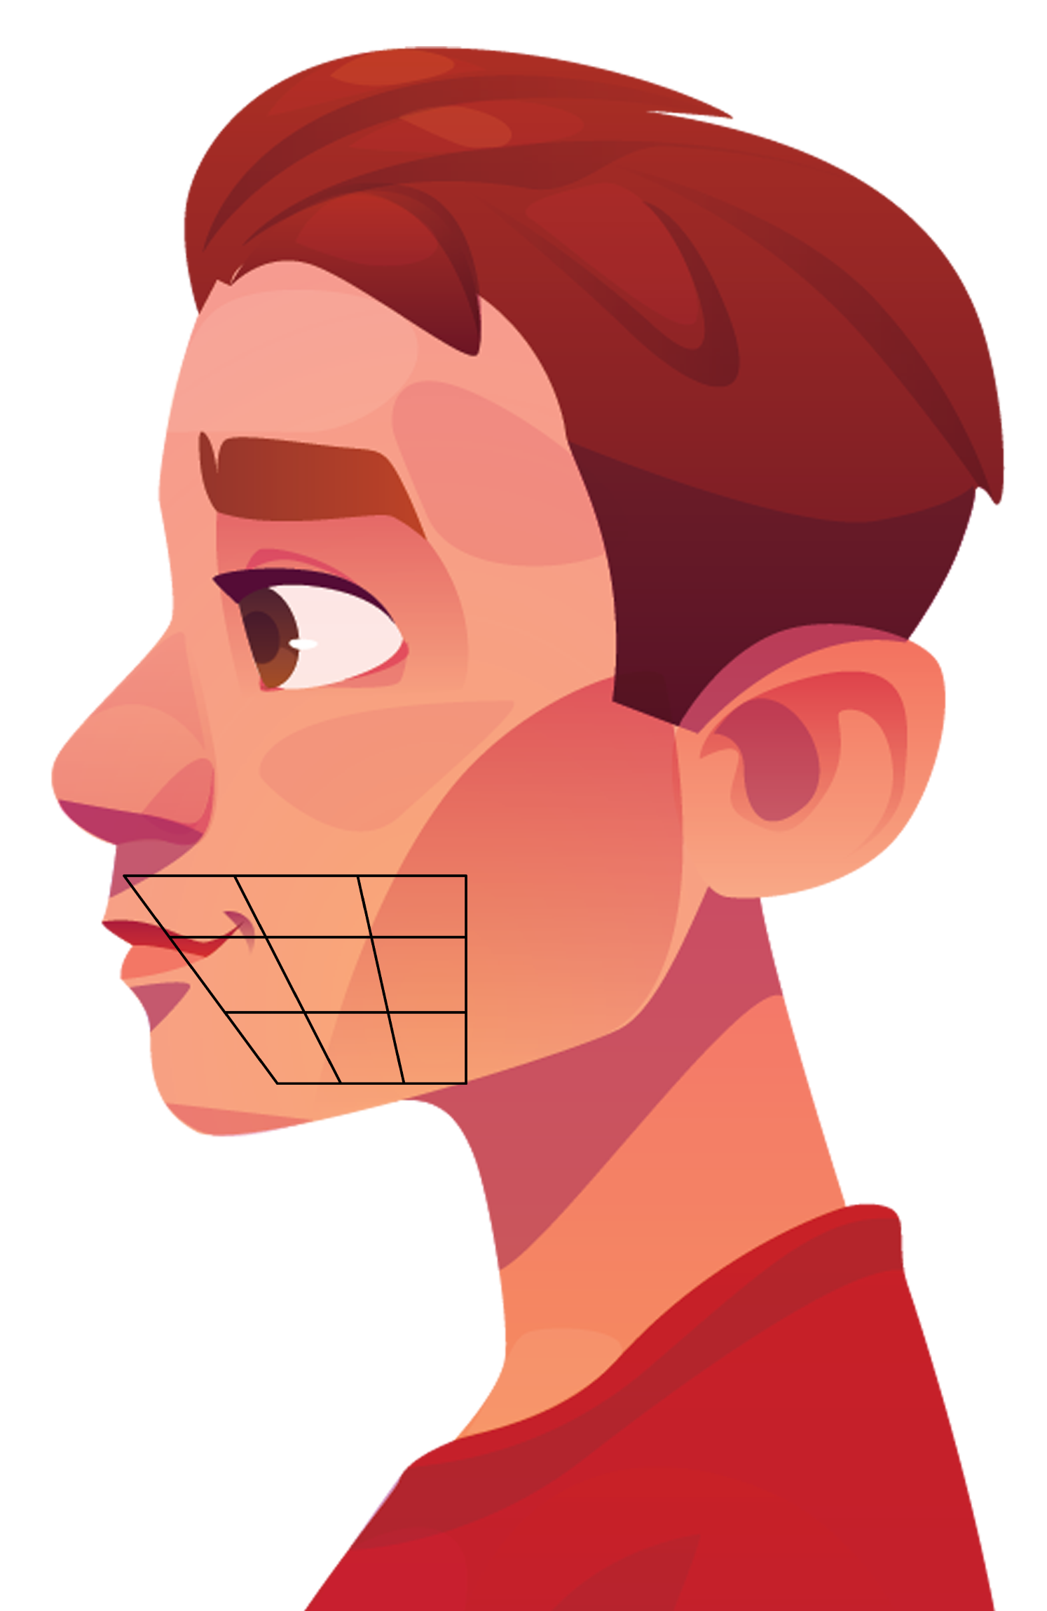

Pay attention to your speech organs!
(The placement of your tongue & jaw)

Slide 5
Green /i:/ silver /ɪ/
Minimal Pairs:

Slide 6
green & silver
Learn the differences!
Pay attention to your speech organs!
Di bahasa Inggris, ada 2 bunyi /i/:
  /i:/ : green, tree, teacher
  /ɪ/ : silver, it, ship
Lebar mulut yang berbeda.
GREEN punya bunyi yang lebih “nyengir” daripada SILVER yang terdengar lebih “males”.
Cara latihan: ‘iiiiiiiii’ lalu buka mulut sedikit!
Pay attention to your speech organs!
Nyengir!!
/i:/
i
lazy..
/ɪ/
e

Slide 7
green & silver
Learn the differences!
Pay attention to your speech organs!
Di bahasa Inggris, ada 2 bunyi /i/:
  /i:/ : green, tree, teacher
  /ɪ/ : silver, it, ship
Biasanya, yang punya bunyi nyengir ejaannya ‘ee/ea’, sedangkan yang males ejaannya ‘i’.
Pay attention to your speech organs!
Nyengir!!
/i:/
i
lazy..
/ɪ/
e

Slide 8

green & silver
Listen to the differences!
/i:/ |  | /ɪ/
BEAD |  | BID
SHEEP |  | SHIP
SEEN |  | SIN
TEEN |  | TIN
STEAL |  | STILL
PEEL |  | PILL
EAT |  | IT
Pay attention to your speech organs!
Pay attention to your speech organs!
Nyengir!!
/i:/
i
lazy..
/ɪ/
e

Slide 9
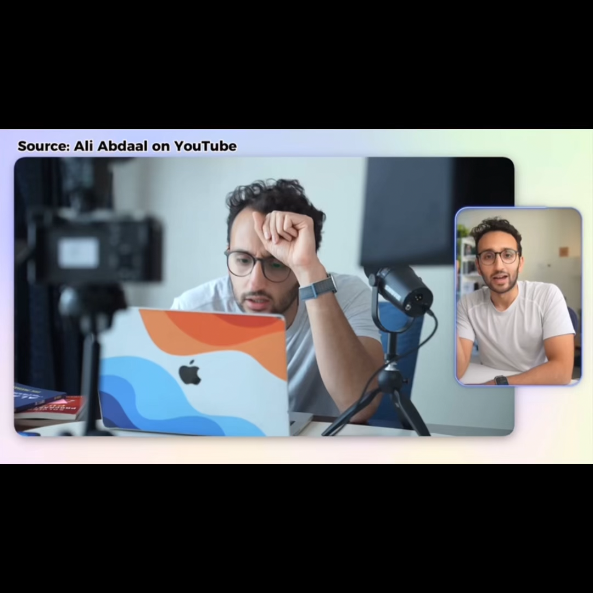
IRL Example

Slide 10
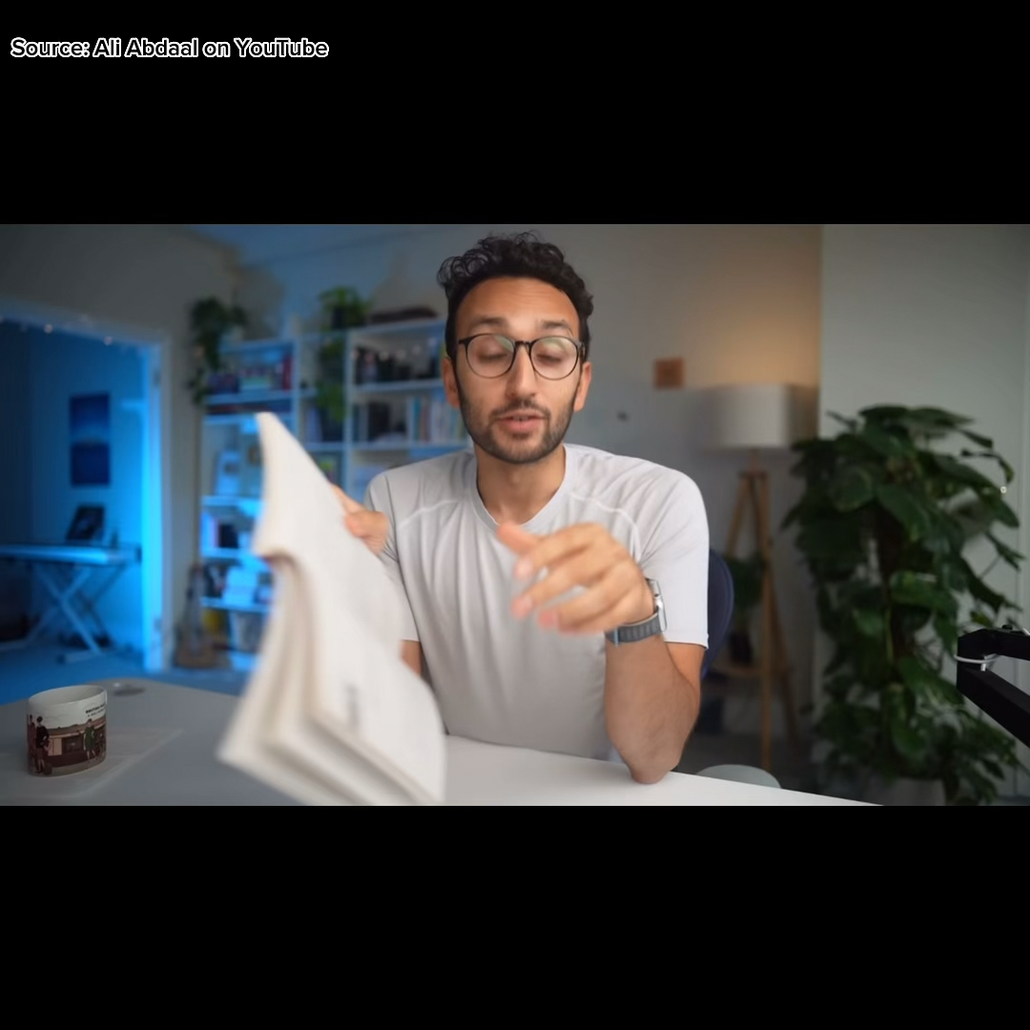
IRL Example

Slide 11
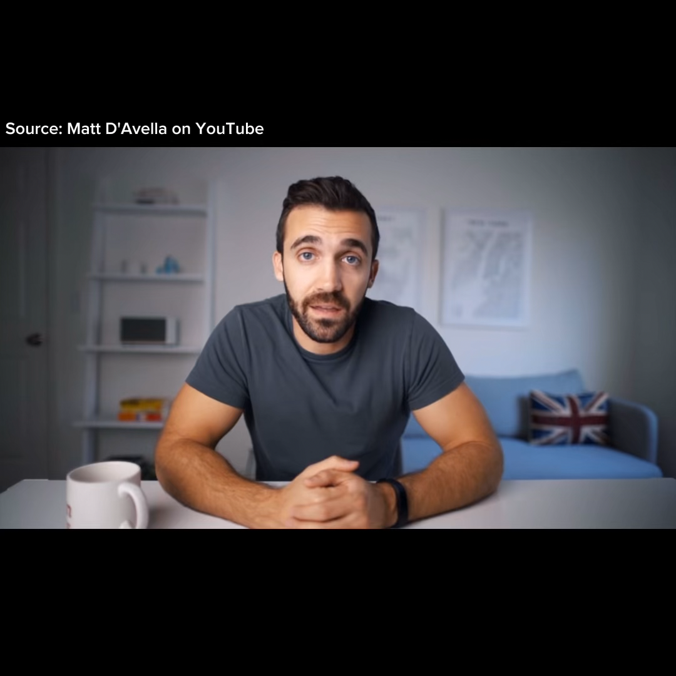
IRL Example

Slide 12
green & silver: practice
The sheep is eating a green leaf.
I have seen it before.
He is still in the ship.
A teen with a ring.
It is a big deer.
Pay attention to your speech organs!
Nyengir!!
/i:/
i
lazy..
/ɪ/
e

Slide 13
-ght
Common mistake:

Slide 14
Common mistake: -ght
-ght
Night | /Nayt/
Bright | /Brayt/
Light | /Layt/
Right | /Rayt/
Fight | /Fayt/
Eight | /Eyt/
The ‘ght’ is invisible. We don’t pronounce it!
We pronounce it as ‘t’.

Slide 15
Green, silver, white, -ght: practice
Green, silver, and white
You eat white rice, right?
She needs some ice on her tea.
I have to tie my shoes.
We ate eight pie last night.

Slide 16


/ˈrɛ
fə
rən
sɪz/
These helped me a lot.
Check them out to find more!
https://www.colorvowel.com/interactive-chart
https://www.americanenglishsounds.net/
https://hadarshemesh.com/
https://forvo.com/
https://www.englishclub.com/

Slide 17
“When learning is hard, you’re doing important work.” So, keep it up!

